Slide 1




DUANG: Lightweight Page Migration in Asymmetric Memory Systems
Hao Wang², Jie Zhang³, Sharmila Shridhar², Gieseo Park⁴, Myoungsoo Jung³, Nam Sung Kim¹
¹ University of Illinois, Urbana-Champaign
² University of Wisconsin, Madison
³ Yonsei University
⁴ University of Texas, Dallas
Notes:
Good morning, everyone. My name is Jie Zhang. Today, I would like to introduce our work, which can reduce the page migration overhead in asymmetric memory system.

Slide 2
Executive Summary
latency-density trade-off
asymmetric memory devices
page placement challenges
  hot page should be in fast region
our solution –
  shared row-buffer architecture
  lightweight page migration
adaptive row-buffer allocation
  configurable based on asymmetric access pattern
Notes:
First, please allow me to use single slides to summarize our work.
The design of memory system has been a trade-off of latency and density.
To take over all the benefits of large capacity and short latency, asymmetric memory system becomes popular, which contains large but slow memory region and small but fast memory region.
However, the performance of such asymmetric memory system is sub-optimal. One of the main challenges comes from page placement. Unless all hot pages can be placed in fast region, the benefits of asymmetric memory devices cannot be fully utilized. However, it is not practical to make a perfect page placement policy. In this paper, we provide an alternative solution which includes modified main memory architecture, and a new lightweight page migration strategy. In addition, we propose an adaptive row-buffer allocation scheme which can be configurable based on asymmetric memory access pattern.

Slide 3
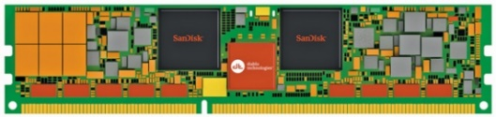
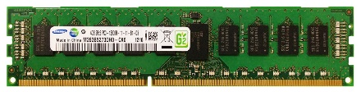
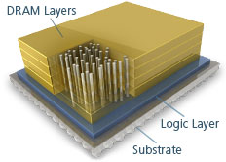
Memory: Fundamental Trade-offs
capacity
overcoming capacity & bandwidth limits of DDRx DIMMs
  capacity using LR-DIMMs or NVM-based DIMMs
    increased latency
  bandwidth using HBM or HMC
    limited capacity and/or increased latency
3DXPoint
DDRx
HBM/HMC
latency
bandwidth
Notes:
The DDR DRAM based memory system has faced many challenges, such as high latency/bandwidth and low capacity. To overcome such challenges, many new techniques have been proposed in the past ten years. For example, 3DXPoints provides much higher density compared to DRR DRAM, but it increases 3~5X latency. On the other hand, HBM and HMC can provide higher bandwidth, but they suffer from the limited capacity. So far, none of current technologies can increase the capacity and reduce the latency.

Slide 4
Latency – Capacity Trade-off
larger capacity (higher density) – longer latency
example 1: DRAM
  larger mat size
  more cells sharing peripherals
  higher density
  longer row cycle time (tRC)
37% tRC reduction
7% area overhead
Notes:
So why larger capacity results in longer latency?
Let’s take DRAM as an example. We assume we have a larger mat size, which means there are more cells sharing the same peripheral circuits. Since the area overhead of pheripheral is less, we can achieve higher density. However, larger mat size means longer wordlines and bitlines which means higher RC delay. On the other hand, if we reduce the MAT size by half, it can shorten the RC time, but the effective memory area is reduced by 7%.

Slide 5
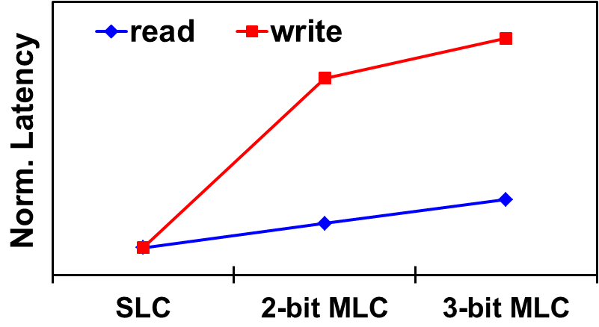
Latency – Capacity Trade-off
larger capacity (higher density) – longer latency
example 1: DRAM
example 2: Phase-Change Memory (PCM)
  a single physical cell can store one or multiple bits
  single-level cell (SLC) or multi-level cell (MLC)
  MLC PCM, higher density, longer latency
Notes:
Another example is phase-change memory. The characteristics of phase change ram is single cell can store one or multiple bits. If phase change ram cell stores 1 bit, it is single-level cell, otherwise, it is multiple level cells. A single level cell only has two resistance states. It can reduce the complexity of data sensing circuit. In other word, it can provide short read/write latency. On the other hand, multi-level cell has more resistance states. It requires multiple iterations to judge the actual resistance values. So, MLC has longer read/write latency. If you look at right figure, you can find out if a cell store more data, the read/write latency will increase.

Slide 6
Asymmetric Memory Devices
tiered-latency DRAM [HPCA-2013]
  bitline segmentation w/ isolation transistors
  fast/small and slow/large segments
asymmetric bank organization [ISCA-2013]
  faster banks w/ smaller mats
  all banks amortize area overhead
hybrid SLC-MLC PCM
  SLC banks & MLC banks in a device
  fast/small and slow/large banks
Notes:
One of good solutions to provide large capacity and short latency is to build up asymmetric memory. Asymmetric memory device contains a small fast region. And the capacity penalty can be overcome by its large slow region. Multiple asymmetric memory systems have been proposed in prior work.
Tiered-latency DRAM partitions the DRAM mat into fast/small region and slow/large region. This can be achieved by using isolation transistors.
Another example is asymmetric bank organization. The memory banks are categorized as fast bank with smaller mats and slow bank with larger mats. The area overhead of fast bank can be amortized by the slow but large bank.
The third example, hybrid SLC-MLC PCM as main memory. Each bank has one type of PCM. So SLC banks become a fast region and MLC banks are slow region.

Slide 7
Big Assumptions
how asymmetric design is assumed to work?
  only a (small) subset of memory pages are hot
  hot pages can be placed in faster regions
  most accesses to faster regions
0x0000
slow & large MLC Banks
0xFFFF
fast & small SLC Banks
Notes:
One question for asymmetric memory device is how asymmetric design can work for main memory. One important observation is that only a small subset of data are hot, so that hot pages can be placed in small but faster regions. The other pages are put in slow but large region. So most access to hot pages can directly go to the faster regions. So that asymmetric memory device can achieve the best performance.

Slide 8
Difficulties in Smart Page Placement
page mapping decision is made in advance
  any runtime statistics not available yet
  typical “profile-and-predict” approach not applicable
access pattern is machine-specific
  filtering effect by cache hierarchy
  “hot” to the program ≠ “hot” to the memory
  compiler-based profiling approach not effective
runtime factors
  interference in shared LLC from co-running applications
dynamic page migration is required !
Notes:
One immature solution to put hot pages in fast region is inventing a perfect page mapping policy, which can put hot pages in faster region at the first time. Such smart page placement may face multiple difficulties. Firstly, page mapping decision is made in advance, so it cannot leverage any runtime statistics. Secondly, the access pattern is machine specific. That is because, the filtering effect by cache hierarchy can impact the access pattern. So the data is hot in program, it may not be hot in memory. Compiler-based profiling approach can be used to find out hot data. But it is less effective for page placement policy approach.
Lastly, the runtime factors can be another challenge. If we execute multiple applications simultaneously, the interference caused by these applications can significantly change the access pattern in memory.
To sum up, we observe a lot of difficulties in just implementing smart page placement. We try to solve the problem in another approach, which is a dynamic page migration.

Slide 9
Current Page Migration Approaches
basic approach
  read & write back through a memory channel
    e.g. 4KB page through a DDR3-1600 channel
    640ns round-trip latency
RowClone [MICRO-2013]
  in-DRAM bulk data copy
    migration bandwidth same as basic approach
    320ns one-way latency
  impact ALL co-running applications
Notes:
The basic approach of page migration is to read/write data back and forth through the memory channel. But it occupies the valuable memory bandwidth and also take huge latency. For example, migrating 4KB data through a DDR3-1600 channel takes 640ns round-trip latency. To reduce this overhead latency, RowClone migrates data via internal data bus. They call it in-DRAM bulk data copy. Instead of migrating data back and forth via memory channel, RowClone uses internal data bus to transfer data from one bank to another bank in one trip. But the disadvantage is the bandwidth of internal data bus is same with memory channel. Even though internal data bus is 64-bit wide and memory channel is 8-bit wide, the clock frequency of internal bus is much slower compared to memory channel. So RowClone only can reduce the latency by 50%. Another disadvantage is the RowClone occupies the internal data bus during data migration, which can impact all co-running applications.

Slide 10
Our Solution – Shared Row-Buffer Arch
decoupled sensing & buffering of PCM
  DRAM: cross-coupled inverter for both sensing & buffering
  PCM: sense amplifiers drive (multiple) explicit latches
shared row-buffer architecture
  share a set of row buffers b/w two neighboring banks
  physically shared, both banks can read & write
  logically partitioned, controlled by the memory controller (MC)
SLC bank
SLC bank
SLC bank
SLC bank
SLC bank
SLC bank
SLC bank
SLC bank
MLC bank
MLC bank
MLC bank
MLC bank
MLC bank
MLC bank
MLC bank
MLC bank
Notes:
In our solution, we first propose a modified row-buffer architecture for phase change ram. Phase change ram is a little different from DRAM. DRAM uses cross-coupled inverters for sensing and buffering. So there is only single row buffer in DRAM. But PCM sense amplifier can drive multiple explicit latches. So PCM has decoupled sensing circuits and buffering circuits. PCM usually has multiple row buffers. In this paper, we assume PCM bank has two row buffers. Our shared row-buffer architecture share a set of row buffers between two neighboring banks. These row buffers are physically connected to two banks. So both banks can read and write data from any row buffer. But in our design, these row buffers are actually logically partitioned, which is controlled by memory controller. So each row buffer has its owner bank. Any accesses coming from other banks are invalidated by memory controller.

Slide 11
Shared Row-Buffer Architecture¹
Architecture – physical view
  split bank architecture
An activate command:
RAS
3-bit bank select
16-bit row address
2-bit row-buffer select
Notes:
In this slides, we show the overview of our shared row-buffer architecture. A PCM bank is partitioned into two sub-banks. Two sub-banks from two banks are grouped in one bank group. 4 row buffers are shared in bank group and connected to the underlying data bus. There is a little modification for main memory command sets. For example, we still can use RAS as an activate command. And we also use 3-bit to select the exact bank and 16-bit to find out the row address. In addition, our architecture needs to use 2-bit to select the row buffer, because we totally have 4 row buffers in one bank group.

Slide 12
Simultaneous Sharing vs. Dynamic Partitioning
simultaneous sharing
  all row buffers logically shared at any time
  2 banks not fully independent, complicate MC design
dynamic partitioning
  logically partitioned, can be re-partitioned at runtime
  MC maintains a 4-bit status register for each pair of banks
Bank 0
Bank 0
Sense-Amps
Sense-Amps
0
0
0
0
1
0
1
1
Sense-Amps
Sense-Amps
Bank 4
Bank 4
Notes:
There are two approaches to use shared row buffer. One is simultaneous sharing, which means all row buffers are logically shared at any time. So the pair banks can compete any row buffer at any time, which makes these two banks are not fully independent. It is difficult to design a command to harmonize the paired bank and also make MC design complicated.
Another approach is dynamic partitioning. We assume the shared row buffers are logically partitioned and have their owner banks, but it is flexible to be re-partitioned at runtime by MC. To implement dynamic partitioning, memory controller only needs to maintain a 4-bit status register for each paired bank. Each bit represents the owner bank for each row buffer. For example, 0011 means the upper two row buffers belonging to Bank 0 and the lower two row buffers belonging to Bank 4. To allocate more row buffer to bank 0, we only change the status register from 0011 to 0001, which means the upper three row buffers belong to Bank 0.

Slide 13
Page Migration Procedure
MC issues an activate
  bring the migrating page into a row buffer from source bank
MC flips the bit in status register
  indicate the row buffer assigned to the destination bank
MC updates the destination row address
MC tags the page as dirty
  sometime later, the page will be written back to destination bank
Notes:
The page migration procedure can be simplified as follows. To migrate one page, firstly, memory controller issue an activate command to one bank which the migrating page. This migrating page will be put into one row buffer, which belongs to the source bank. Then the memory controller can flip the bit in status register, which means the owner bank of the row buffer has been changed to our target bank. Afterwards, memory controller updates the destination row address to indicate the location where to put data in destination bank. At last, memory controller just tag this page as dirty. We do not need to care about evicting data from row buffer to destination bank. Because, later on, this page will be written back to destination bank naturally. This approach has several benefits. Firstly, the cost of page migration is low. We do not need to care about evicting data from row buffer to destination bank. This can be done as a background. Secondly, our approach does not occupy internal data bus and memory controller, which allows co-running applications to execute.

Slide 14
Data Management
clarification for “page”
  block of data in a row in SLC bank
  not necessarily aligned with a OS physical page frame (e.g., 4KB)
  a row in MLC bank has 3 pages
  row-buffer size = page size
unified memory space
  store data exclusively
  page swap between SLC and MLC bank
hardware-managed page translation table
  OS-transparent
translation buffer
  TLB-like structure
Notes:
The data management for PCM is a little different from DRAM. We assume one page is a data block in a row in SLC bank. But the page size is not necessarily aligned with OS physical page frame size. Thus, a MLC bank can have a 3 pages in a row. Instead, we assume row-buffer size is similar to page size.
In our hybrid PCM memory, the relationship of SLC and MLC is exclusive caching. Fast and small SLC banks can be regarded as an exclusive cache for MLC banks. So the page swapping can be naturally performed on every cache replacement.
Since pages can be swapped between SLC and MLC PCM banks, we introduce a hardware-managed page translation table to find out the exact location of target data. The benefits of our proposed page translation table is it is transparent to operating system, which can minimize the modification to the host.
Like the TLB over page table, we also introduce a translation buffer to reduce the access latency of page translation.

Slide 15
Page Translation Table
direct mapped scheme
  limit mapping flexibility, reduce translation table size
  1 physical row in SLC (MLC) bank has 1 (3) page slot(s)
  4 pages in 2 paired rows (a logical row) as a page group
page translation table entry
  2 bits for each page, 8 bits for each logical row
Notes:
In our page translation table design, we choose to use direct mapped scheme. Although it limits the mapping flexibility, it can effectively reduce the page translation table size. We assume 1 physical row in SLC bank has 1 page slot and 1 physical row in MLC bank has 3 page slots. Two physical rows from SLC bank and MLC bank with the row index can be regarded as one logical row and physical row index is used as the logical row index. These four pages are grouped as a page group. Pages are limited to migrate within its page group. So two bits are good enough to find out the page location within page group. And totally 8 bits are used to track the whole logical row, which becomes one page translation table entry. As shown in the right figure, to find out the remapped physical shot, we first need to use logical row index to locate the page translation table entry. Based on the page index, we can find out the remapped page index. As shown in the shadowed region, page 2 has swapped with page 3, which means page 2 right now locates in SLC bank.

Slide 16
Translation Buffer
page translation table size
  2GB per rank, 4KB page size, 8 banks
  32768 physical rows, 32KB storage
  full table in first 8 rows of the SLC bank (32KB)
translation buffer
  cache recently-used page translation entries
  tracking info of 4 page groups in one buffer entry
  128-entry, 32-way set associative (0.7KB on-chip storage)
Notes:
For each pair of banks, we need to compose one page translation table. Let’s assume we have 2GB data in one rank. The page size is 4KB and there are 8 banks. So for one bank, there are totally 32K physical rows. Thus, one page translation table has 32K entries and requires 32KB storage. Although we have largely reduced the translation table size, it is still too large to put into on-chip storage. So we suggest to put translation table into the fast SLC banks. When booting up, the OS is informed which frame they cannot use for frame mapping.
Putting page translation table can introduce extra overhead. Because every data access has to visit SLC PCM bank to look up page translation table. After getting location of the page, it has to visit the main memory again. To reduce page translation table look up overhead, we introduce translation buffer, which can cache recently-used page translation entries. The following figure shows the structure of our translation buffer. We group four page translation entries in one row. The 13 most significant bits of the row index are used to compare the tag. And the 2-bit least significant bits are used to select the required page translation entry. Then we can use the page index to find out the remapped page index. We assume translation buffer has 128 entries and it is 3-way set associative. So total size of translation buffer is 0.7KB, which can be put into on-chip storage.

Slide 17
Page Swapping
procedure
Page 0
Page 1
Page 2
0
0
translation entry
1
00
01
10
11
1
∙ ∙ ∙
status register
request queue
Page 3
Notes:
The detailed procedure of page swapping incorporating our new components are shown in this figure. According to status register, the upper two row buffers belong to MLC bank and the lower two row buffers belong to SLC bank. And page translation table entry shows the four pages are put in order, so no pages are swapped before.

Slide 18
Page Swapping
procedure
  a req to MLC bank incurs page swapping (triggering req)
Address mapping
addr
req
Page 0
Page 1
Page 2
0
0
translation entry
1
00
01
10
11
1
∙ ∙ ∙
status register
request queue
Page 3
Notes:
At first, a request is pushed into request queue. By address mapping, this request is mapped to MLC bank, which incurs a page swapping.

Slide 19
Page Swapping
procedure
  a req to MLC bank incurs page swapping (triggering req)
Address mapping
addr
req
Page 0
Page 1
Page 2
0
0
translation entry
1
00
01
10
11
1
∙ ∙ ∙
status register
request queue
Page 3
Notes:
When a memory request arrives to access the MLC bank, it will incurs page swapping. We call this is triggering request.

Slide 20
Page Swapping
procedure
  a req to MLC bank incurs page swapping (triggering req)
Address mapping
addr
req
Page 0
Page 1
Page 2
0
0
translation entry
1
00
01
10
11
t-req
1
∙ ∙ ∙
status register
request queue
Page 3
Notes:
Memory controller put the triggering request in request queue as normal.

Slide 21
Page Swapping
procedure
  a req to MLC bank incurs page swapping (triggering req, t-req)
  MC creates a pseudo triggering req (pt-req) to SLC bank
Address mapping
addr
req
Page 0
Page 1
Page 2
0
0
translation entry
pt-req
1
00
01
10
11
t-req
1
∙ ∙ ∙
status register
request queue
Page 3
Notes:
But, in addition, right after the trigger request, memory controller creates a pseudo triggering request, which will access a page in SLC bank. The pages accessed by triggering request and pseudo triggering request belong to the same page group, which follows the page remapping scheme.

Slide 22
Page Swapping
procedure
  a req to MLC bank incurs page swapping (triggering req, t-req)
  MC creates a pseudo triggering req (pt-req) to SLC bank
  2 triggering reqs bring to-be-swapped pages in row buffers
Address mapping
addr
req
Page 0
Page 1
Page 2
0
0
translation entry
pt-req
1
00
01
10
11
t-req
1
∙ ∙ ∙
status register
request queue
Page 3
Notes:
When these two triggering requests are popped from request queue, they bring the two pages in row buffers.

Slide 23
Page Swapping
procedure
  a req to MLC bank incurs page swapping (triggering req, t-req)
  MC creates a pseudo triggering req (pt-req) to SLC bank
  2 triggering reqs bring to-be-swapped pages in row buffers
  update page-slot indices tracked by MC
Address mapping
addr
req
Page 0
Page 1
Page 2
0
0
translation entry
pt-req
1
11
01
10
00
t-req
1
∙ ∙ ∙
status register
request queue
Page 3
Notes:
Then memory controller updates the page translation table entry to indicate the destination address of the pages in the row buffers. For example, in the figure, page 0 will be swapped to the SLC bank and page 3 will be put into MLC bank.

Slide 24
Page Swapping
procedure
  a req to MLC bank incurs page swapping (triggering req)
  MC creates a pseudo triggering req to SLC bank
  2 triggering reqs bring to-be-swapped pages in row buffers
  update page-slot indices tracked by MC
  update bits in status register, tag as dirty
Address mapping
addr
req
Page 0
Page 1
Page 2
1
0
translation entry
pt-req
1
11
01
10
10
t-req
0
∙ ∙ ∙
status register
request queue
Page 3
Notes:
Afterwards memory controller update the status register to change the owner bank of each row buffer. Memory controller also tag these two row buffers as dirty. Sometimes later on, the pages in row buffers will be evicted to their banks.

Slide 25
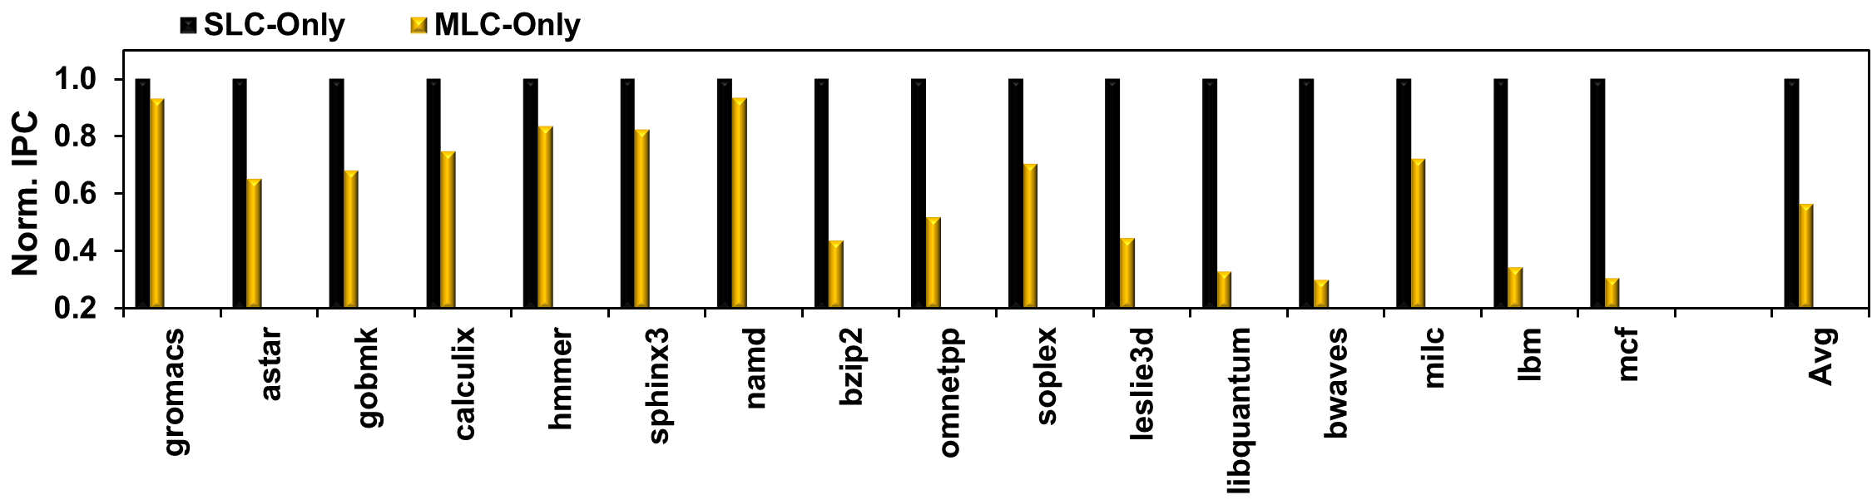
Performance: CPU Single Program
configuration
  SLC-Only/MLC-Only: only SLC/MLC banks
  LPM (SLC-MLC): hybrid SLC-MLC banks, use our lightweight page migration (LPM) for swapping pages
results
  MLC-Only achieves 57% performance of SLC-Only
Notes:
In the evaluation, we compare our light-weight page migration strategy with other common main memory configurations.
Firstly, we configure SLC-only and MLC-only, which are only SLC/MLC banks. We compare their performance under single CPU program. As shown in the figure, the MLC-only achieves 57% performance compared to SLC-only.

Slide 26
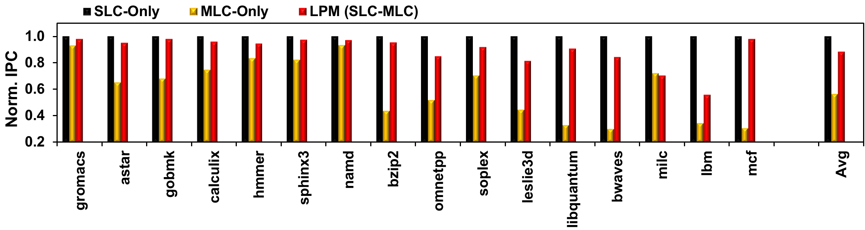
Performance: CPU Single Program
configuration
  SLC-Only/MLC-Only: only SLC/MLC banks
  LPM (SLC-MLC): SLC-MLC hybrid, use our lightweight page migration (LPM) for swapping pages
results
  MLC-Only achieves 57% performance of SLC-Only
  LPM (SLC-MLC) achieves 89% performance of SLC-Only
Notes:
LPM is a hybrid SLC-MLC PCM system, which uses our light-weight page migration (LPM) for swapping pages.
Since LPM can migrate hot pages in fast SLC region, our LPM is much better than MLC-only approach and finally it can achieve 89% performance compared to SLC-only banks.

Slide 27
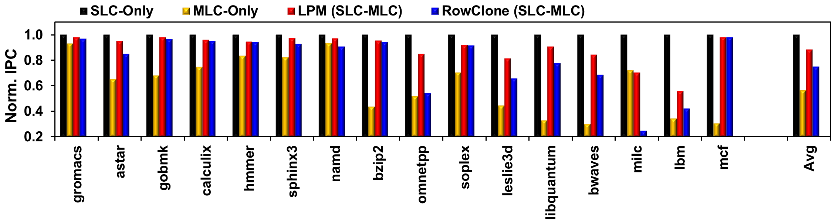
Performance: CPU Single Program
configuration
  SLC-Only/MLC-Only: only SLC/MLC banks
  LPM (SLC-MLC): SLC-MLC hybrid, use our lightweight page migration (LPM) for swapping pages
  RowClone (SLC-MLC) : SLC-MLC hybrid, use RowClone
results
  MLC-Only achieves 57% performance of SLC-Only
  LPM (SLC-MLC) achieves 89% performance of SLC-Only
  RowClone (SLC-MLC) achieves 75% performance of SLC-Only
Notes:
The fourth configuration is RowClone. It also uses SLC and MLC banks. Compared to our light-weight page migration strategy, RowClone consumes more time for page migration. Thus its performance is worse than our work. A hybrid PCM system employing RowClone achieves 75% performance of SLC only.

Slide 28
Performance: CPU Multiple Programs
configuration
  SLC-Only/MLC-Only: only SLC/MLC banks
  LPM (SLC-MLC): SLC-MLC hybrid, use our lightweight page migration (LPM) for swapping pages
  RowClone (SLC-MLC) : SLC-MLC hybrid, use RowClone
results
Notes:
We also compare the performance of each configuration under multiple CPU programs, so that we can check the impact to co-running applications.

Slide 29
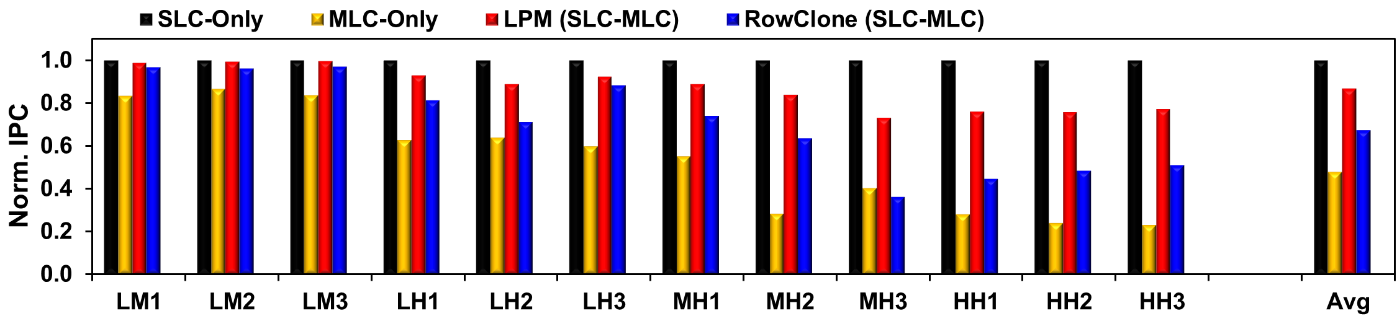
Performance: CPU Multiple Programs
configuration
  SLC-Only/MLC-Only: only SLC/MLC banks
  LPM (SLC-MLC): SLC-MLC hybrid, use our lightweight page migration (LPM) for swapping pages
  RowClone (SLC-MLC) : SLC-MLC hybrid, use RowClone
results
  LPM (SLC-MLC) – 87% vs. RowClone (SLC-MLC) – 67%
  recall for single CPU benchmark, 89% vs. 75%
  RowClone hurts all co-running applications
Notes:
Key point:
A particular disadvantage for RowClone: during page migration, have to suspend the memory channel, and thus hurt every co-running applications.
As shown in the figure, the LPM achieve 87% performance compared to SLC-only banks, while RowClone achieves 67% performance.
Recall that the LPM and RowClone achieves 89% and 75% in single CPU benchmark. We can observe a significant performance of RowClone in CPU multiple programs. That’s because, during the page migration, RowClone has to suspend internal data bus, which can hurt every co-running applications.

Slide 30
Adaptive Row-Buffer Allocation (RBA)
imbalanced access pattern
  SLC banks more frequently accessed
  more page conflicts in SLC banks, longer queuing latency
  reduced effective bank-level parallelism
  e.g., lbm, very sensitive to # of banks, only achieves 56%
adaptive asymmetry
  configure asymmetric RBA based on runtime access patterns
  MC takes one row buffer from MLC banks, allocates to SLC banks
Notes:
We observe the access pattern is imbalanced in SLC and MLC PCM banks. Especially for our lightweight page migration scheme, SLC banks are more heavily accessed. So there are more page conflicts in SLC banks and also it causes longer queuing latency. Another disadvantage is it can reduce the effective bank-level parallelism. If we see the performance of our LPM and SLC-only, some workloads have huge performance degradation. For example, in workload lbm, LPM has only achieve 56% performance compared to SLC-only. That is because, lbm is very sensitive to the number of banks. Since imbalanced access pattern will reduce bank-level parallelism, the performance of lbm will degrade.
To overcome this challenge, we propose to allocate row buffers dynamically based on the runtime access patterns. If there are heavy accesses in SLC bank, memory controller will take one row buffer from MLC banks and allocate it to SLC banks, so that SLC bank can utilize the row buffer level parallelism.
The figure shows that for some benchmarks (memory-intensive ones), LPM (SLC-MLC) not good enough.

Slide 31
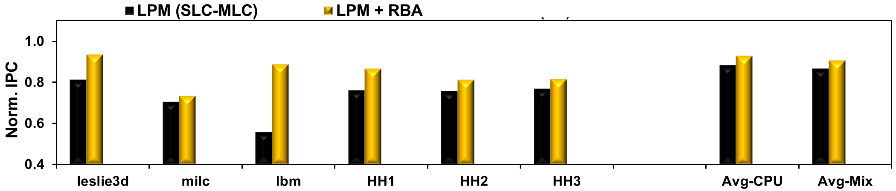
Performance: CPU Adaptive RBA
configuration
  LPM + RBA: adding row-buffer allocation (RBA) atop LPM
  LPM (FA) + RBA: LPM + RBA but allowing a page to be freely migrated to any row, instead of within a logical row
  OraclePlacement: SLC-MLC hybrid, hot pages directly placed in SLC banks with perfect future knowledge
results
  LPM: 91% (CPU) / 89% (MIX)
  LPM + RBA: 93% (CPU) / 91% (MIX)
Notes:
We integrate adaptive row buffer allocation in our LPM scheme. It can improve the performance compared to LPM-only. Especially for some workloads such lbm, the performance is improved by more than 70%.

Slide 32
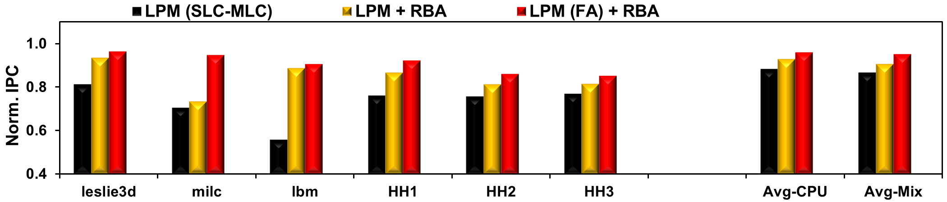
Performance: CPU Adaptive RBA
configuration
  LPM + RBA: adding row-buffer allocation (RBA) atop LPM
  LPM (FA) + RBA: LPM + RBA but allowing a page to be freely migrated to any row, instead of within a logical row
  OraclePlacement: SLC-MLC hybrid, hot pages directly placed in SLC banks with perfect future knowledge
results
  LPM: 91% (CPU) / 89% (MIX)
  LPM + RBA: 93% (CPU) / 91% (MIX)
  LPM (FA) + RBA: 96% (CPU) / 95% (MIX)
Notes:
To minimize the cost of page translation table, we limit page mapping policy. But the system performance can improve further if we allow a page to be freely migrated to any row. We add extra configuration which support free page migration. The figure shows the LPM+RBA with free migration can achieve better performance.

Slide 33
Summary
asymmetric architectures exploit latency-density trade-off
  A low-overhead page migration is required
shared row-buffer architecture for PCM
lightweight in-memory, high-bandwidth page migration (LPM)
  naturally done, no explicit copy
  demonstrate on a hybrid SLC-MLC memory system
  capture 87%-89% performance of an SLC-Only memory system
adaptive row-buffer allocation (RBA)
  assign more row buffers to more heavily-accessed banks
  combine with LPM, capture 91%-93% performance of an SLC-Only memory system
Notes:
To sum up, asymmetric architecture can exploit the tradeoff of latency and density. But it requires a low-overhead page migration scheme.
In our solution, we propose a shared row-buffer architecture for PCM. And also we propose a lightweight page migration scheme, which can naturally complete without any explicit copy. It can fully fit in SLC-MLC hybrid memory system. And it can capture most of performance compared to SLC-only memory system.
In addition, we observe asymmetric memory access pattern. To overcome this challenge, we introduce adaptive row buffer allocation, which can allocate more row buffers to heavily-accessed banks. Combining adaptive row-buffer allocation scheme with LPM can achieve more performance benefits.

Slide 34
Thank you!

Slide 35
Backup slides

Slide 36
Shared Row-Buffer Architecture²
Circuit implementation
  bank access lines (BALs) connect all 4 row buffers
  S/A Gates connect BALs & sense amplifiers
  a decoder controls I/O Access Gates & Bank Access Gates

Slide 37
Simulation Infrastructure
Integrated gem5+GPGPU-Sim simulator
  lockstep execution of gem5 & GPGPU-Sim
  shared memory channels between CPU & GPU
  Released at http://cpu-gpu-sim.ece.wisc.edu
    5057 visits, 213 registered users since 03/2013.

Slide 38
Timing Protocol
Consecutive activates to paired banks
  S/A Gates turned on for 1 internal cycle (4 external cycles)
  at least 4-cycle delay b/w consecutive activates to paired banks
An activate followed by a write-back to paired banks
  read turns on S/A Gates at the end of tRCD
  write turns on S/A Gates at the beginning of tRP
  4-cycle write-restricted window

Slide 39
Address Mapping
Physical address to memory device address
  Page 0 - 24
0
1
2
3
16
4
17
5
18
6
28
19
7
20
8
21
9
22
10
0
23
11
12
13
14
15

Slide 40
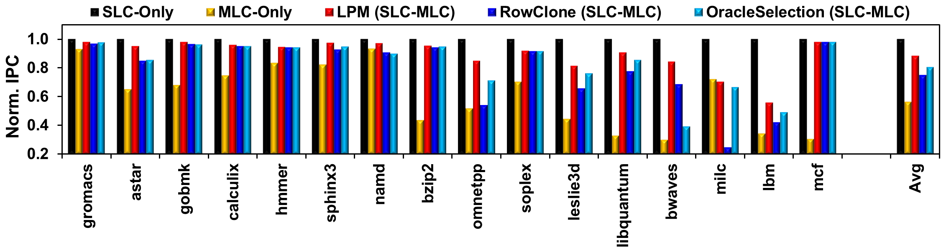
Performance: CPU Single Program
configuration
  SLC-Only/MLC-Only: only SLC/MLC banks
  LPM (SLC-MLC): hybrid SLC-MLC banks, use our lightweight page migration (LPM) for swapping pages
  RowClone (SLC-MLC) : hybrid SLC-MLC banks, use RowClone
  OracleSelection (SLC-MLC): better hot page selection with perfect runtime profiling results
results
  LPM : RowClone : OracleSelection = 89% : 75% : 81%

Slide 41
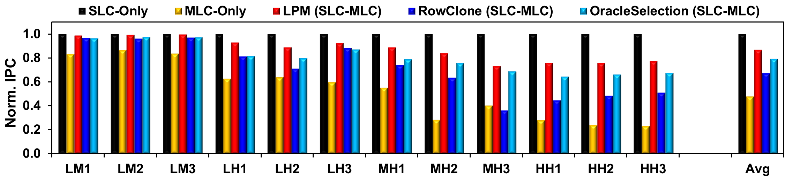
Performance: CPU Multiple Programs
configuration
  SLC-Only/MLC-Only: only SLC/MLC banks
  LPM (SLC-MLC): hybrid SLC-MLC banks, use our lightweight page migration (LPM) for swapping pages
  RowClone (SLC-MLC) : hybrid SLC-MLC banks, use RowClone
  OracleSelection (SLC-MLC): better hot page selection with perfect runtime profiling results
results
  LPM : RowClone : OracleSelection = 87% : 67% : 79%

Slide 42
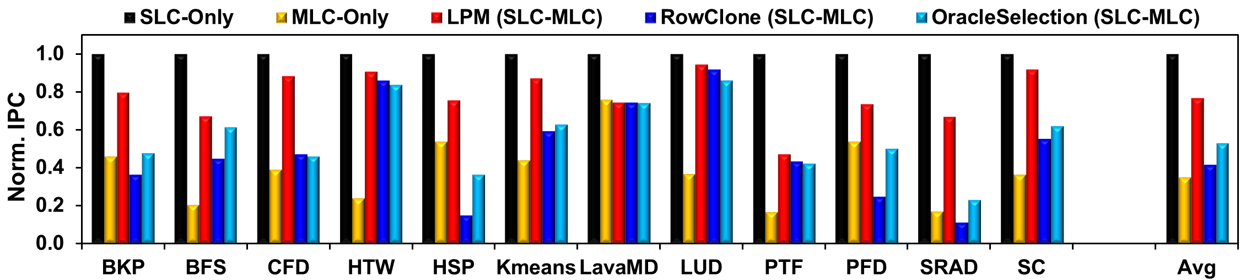
Performance: GPU Program
configuration
  SLC-Only/MLC-Only: only SLC/MLC banks
  LPM (SLC-MLC): hybrid SLC-MLC banks, use our lightweight page migration (LPM) for swapping pages
  RowClone (SLC-MLC) : hybrid SLC-MLC banks, use RowClone
  OracleSelection (SLC-MLC): better hot page selection with perfect runtime profiling results
results
  LPM : RowClone : OracleSelection = 77% : 42% : 53%
Notes:
“oracle” in OracleSelection refers to that it is challenging to track access count for each page, and sort all pages periodically at runtime.

Slide 43
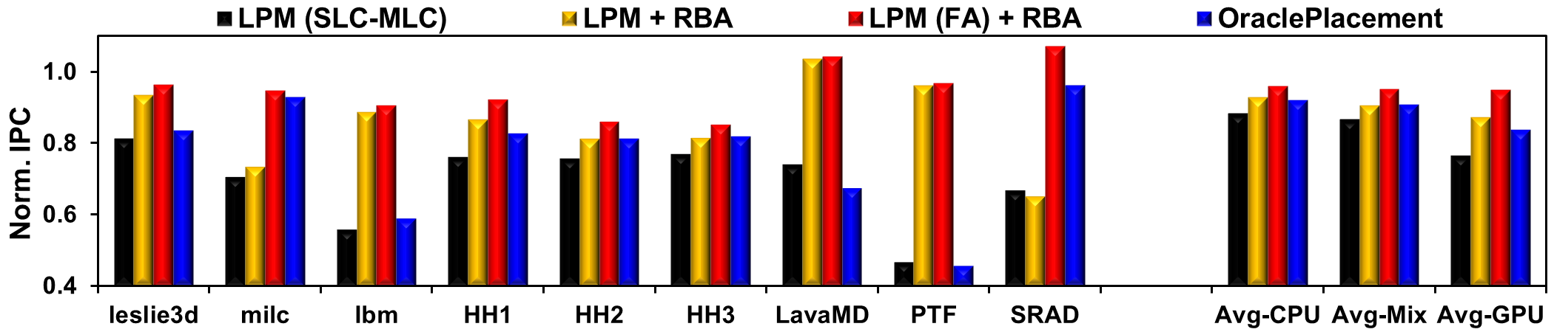
Performance: GPU Adaptive RBA
configuration
  LPM + RBA: adding row-buffer allocation (RBA) atop LPM
  LPM (FA) + RBA: LPM + RBA but allowing a page to be freely migrated to any row, instead of within a logical row
  OraclePlacement: SLC-MLC hybrid, hot pages directly placed in SLC banks with perfect future knowledge
results
  LPM: 91% (CPU) / 89% (MIX) / 77% (GPU)
  LPM + RBA: 93% (CPU) / 91% (MIX) / 87% (GPU)
  LPM (FA) + RBA: 96% (CPU) / 95% (MIX) / 95% (GPU)
  OraclePlacement: 92% (CPU) / 91% (MIX) / 84% (GPU)
Notes:
Key point:
A particular disadvantage for RowClone: during page migration, have to suspend the memory channel, and thus hurt every co-running applications.

Slide 44
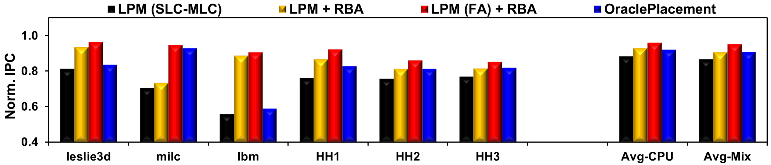
Performance: CPU Adaptive RBA
configuration
  LPM + RBA: adding row-buffer allocation (RBA) atop LPM
  LPM (FA) + RBA: LPM + RBA but allowing a page to be freely migrated to any row, instead of within a logical row
  OraclePlacement: SLC-MLC hybrid, hot pages directly placed in SLC banks with perfect future knowledge
results
  LPM: 91% (CPU) / 89% (MIX)
  LPM + RBA: 93% (CPU) / 91% (MIX)
  LPM (FA) + RBA: 96% (CPU) / 95% (MIX)
  OraclePlacement: 92% (CPU) / 91% (MIX)
Notes:
Lastly, we add configuration of OraclePlacement, which is a perfect page placement scheme, because it can leverage perfect future knowledge. It shows that an OraclePlacement is still worse than our page migration strategy. That’s because, our LPM can dynamically migrate hot pages to fast region whenever the pages become hot.

Slide 45
PCM+DRAM Memory Systems
CPU
CPU
{TSV, SI}
{DDR, TSV, SI}
DDR
fast
(DRAM)
fast
(DRAM)
fast
(DRAM)
DDR
unified memory space
slow
(NVM)
slow
(NVM)
slow
(NVM)
page
disk
disk
Notes:
There are many options regarding PCM+DRAM memory system design.
LPM can be used for the NVM in a PCM+DRAM system.

Slide 46
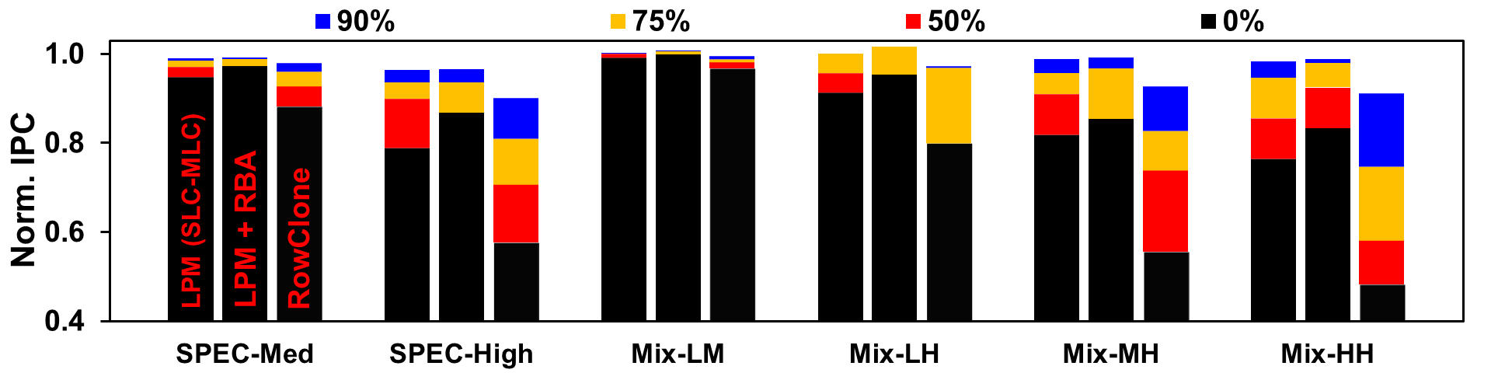
Performance in PCM+DRAM
evaluation methodology
  vary the percentage of memory accesses serviced by DRAM
results

